Slide 1
CSYE7200- Final project Topic – profit potentials for airbnb
Team 3
Aman Gupta – 001448126
Rajat Jaswal - 001443168

Slide 2
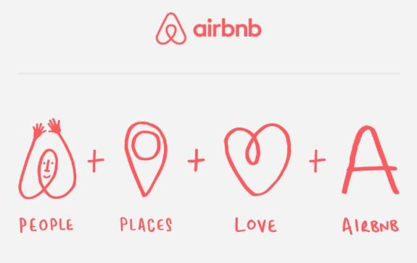
GOALS
Increase Airbnb Profits by acquiring houses

Slide 3
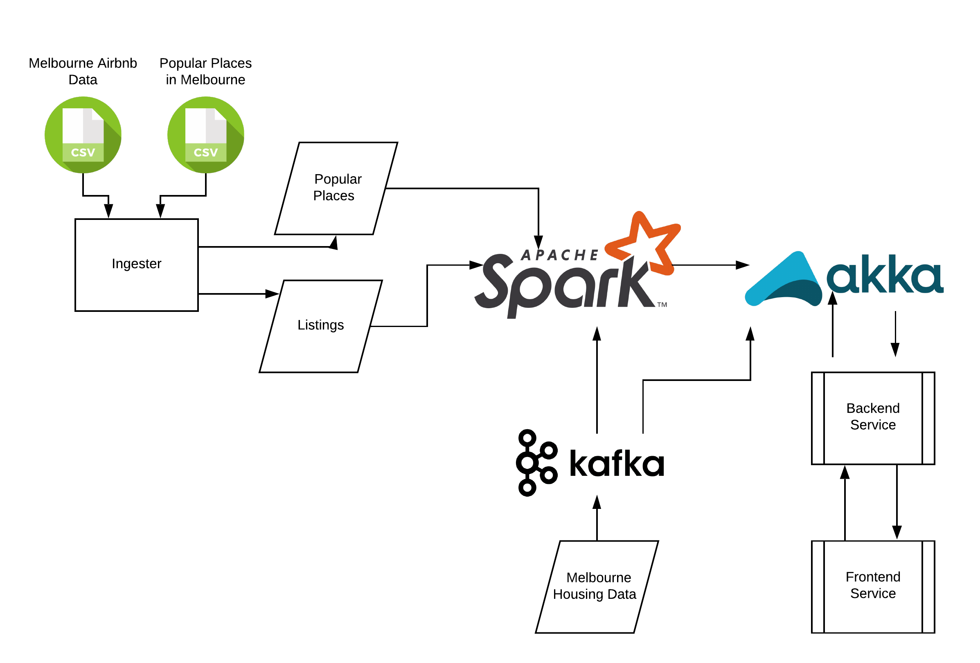
Architecture

Slide 4
USE cases
User opens the map and visualizes already existing Airbnb Listings, Popular Areas
User inputs bunch of House Addresses that are to be predicted by the system to be acquired as Potential Airbnb Listing
User visualizes the results on the map

Slide 5
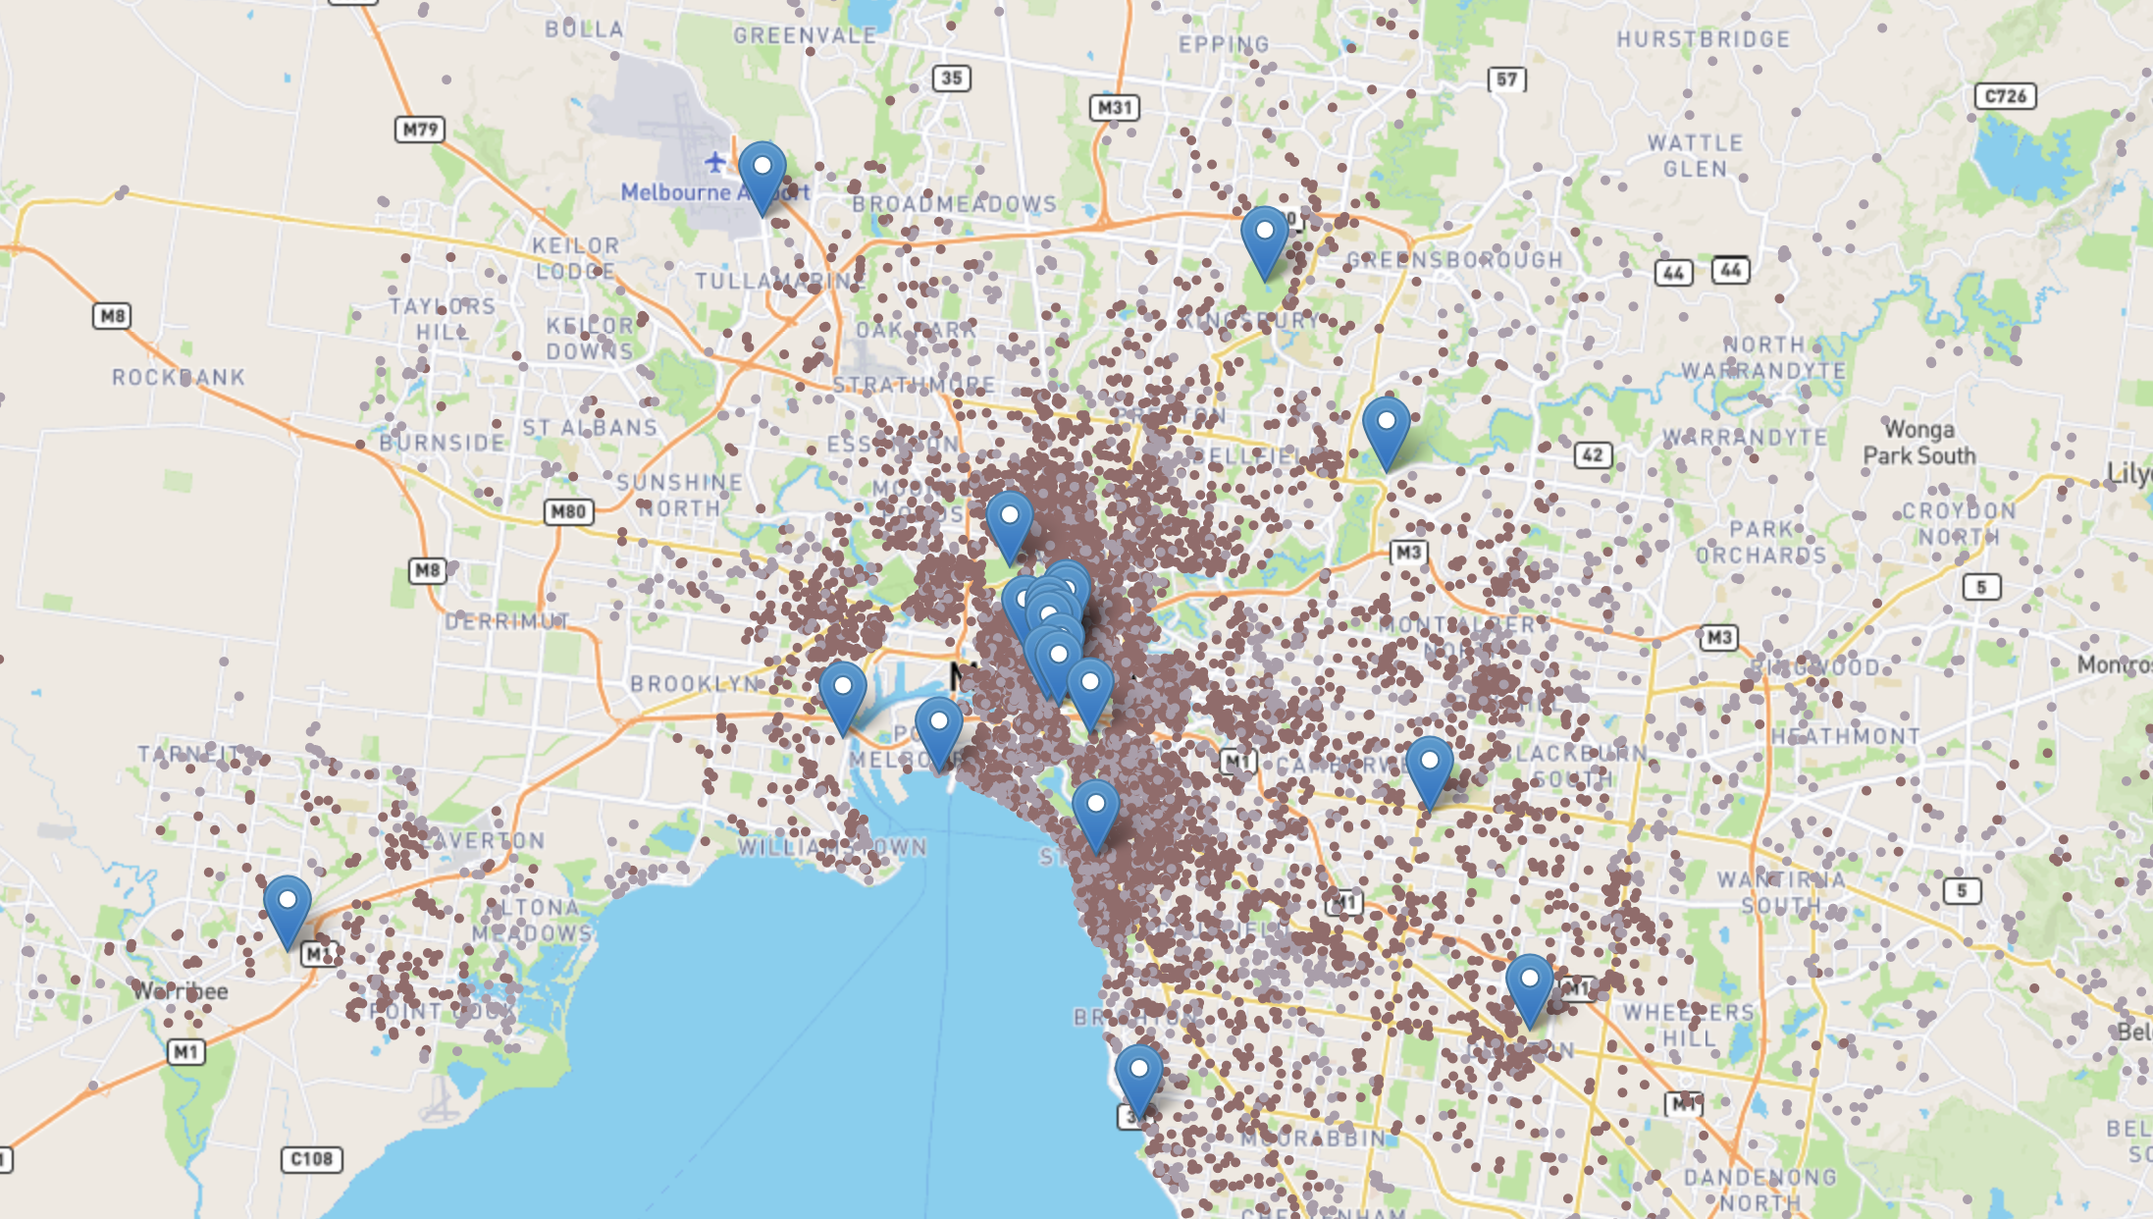
USE case -1
User opens the map and visualizes already existing Airbnb Listings, Popular Areas
Pins - Popular Area
Dark Brown - Airbnb Listing that is valid
Light Brown - Airbnb Listing that is not valid

Slide 6
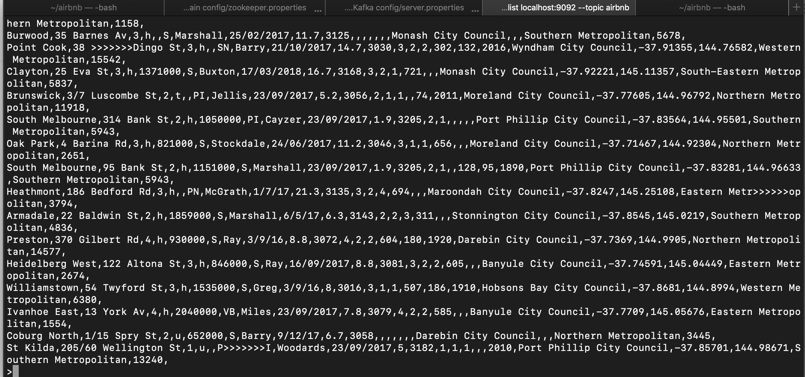
USE case -2
User inputs bunch of House Addresses that are to be predicted by the system to be acquired as Potential Airbnb Listing
Data Inserted through Kafka Producer via CLI

Slide 7
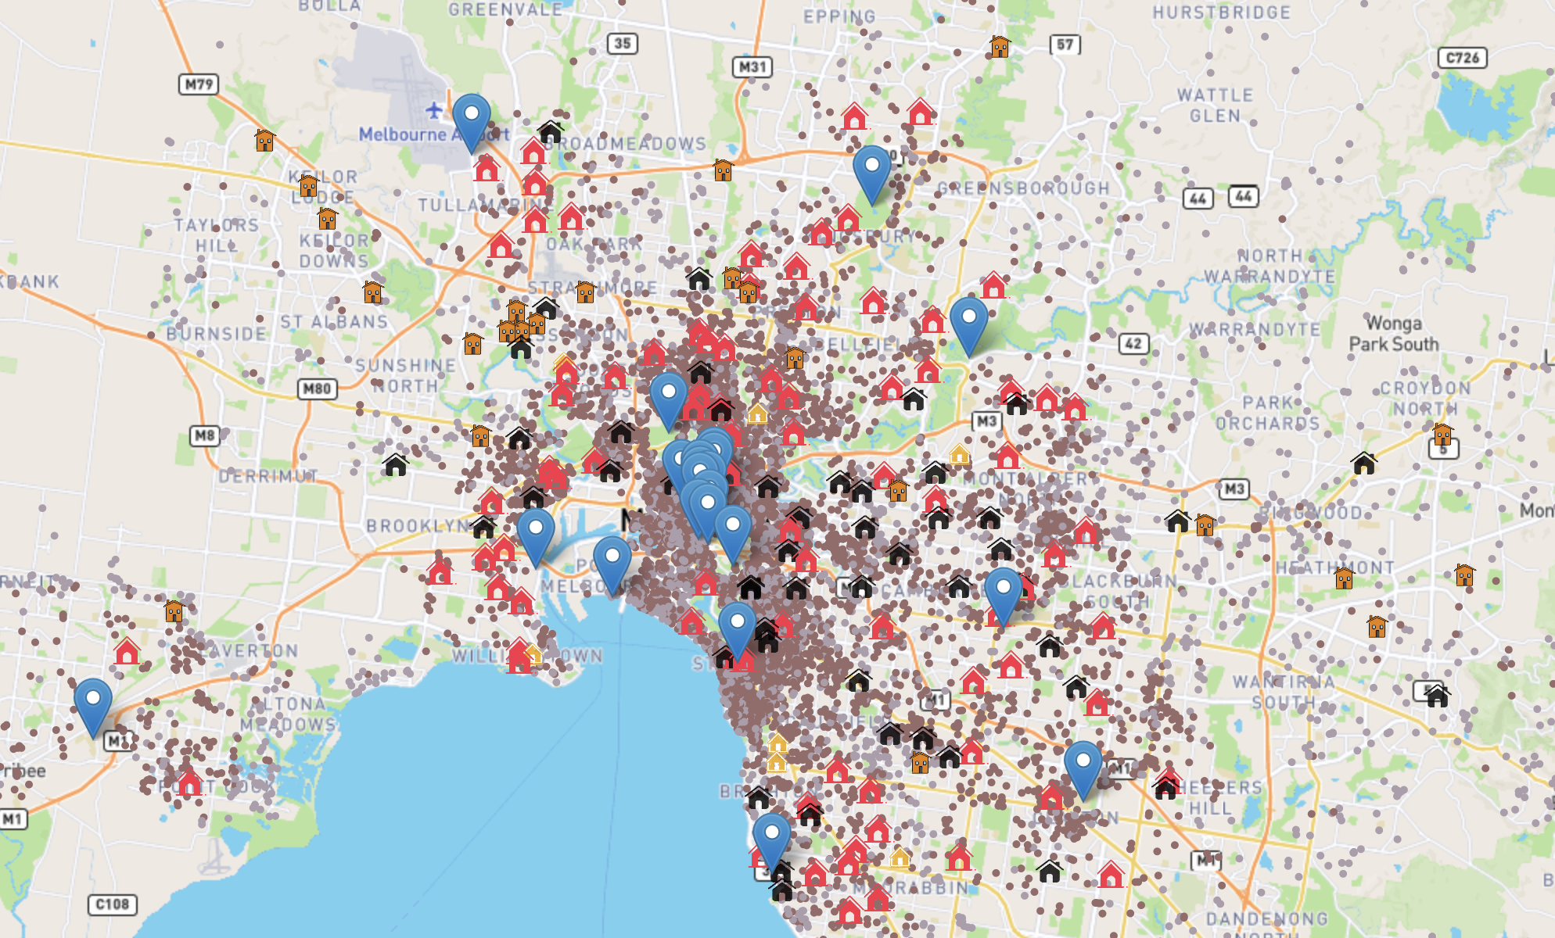




USE case -3(a)
User visualizes the results on the map
House if acquired can benefit Airbnb Profits
House if acquired does not benefit Airbnb
Potential House address predicted, but should be Non-Potential (False Positive)
Non-Potential House address predicted, but should be Potential (False Negative)

Slide 8
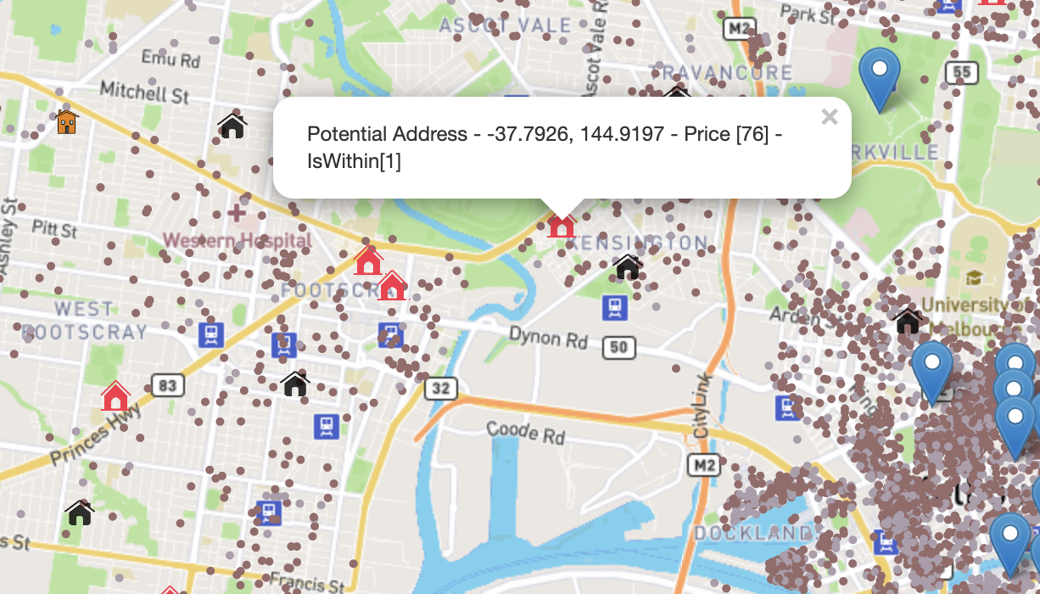
USE case -3(B)
Airbnb Acquired House Address
House if acquired benefits Airbnb Profits

Slide 9
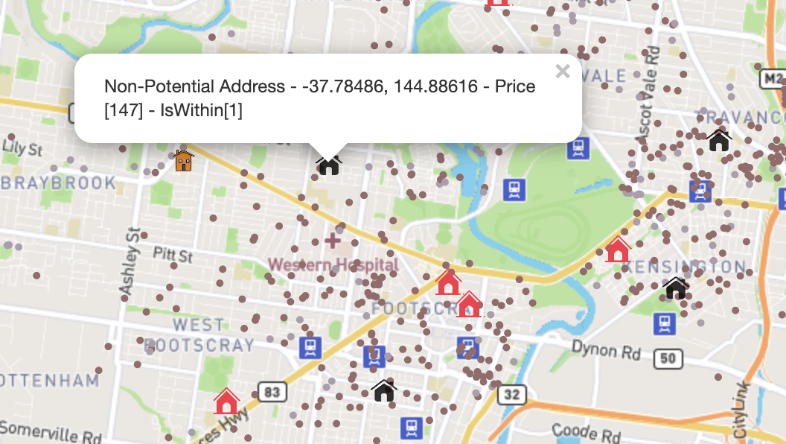
USE case -3(C)
Non-acquired houses
House if acquired does not benefit Airbnb

Slide 10
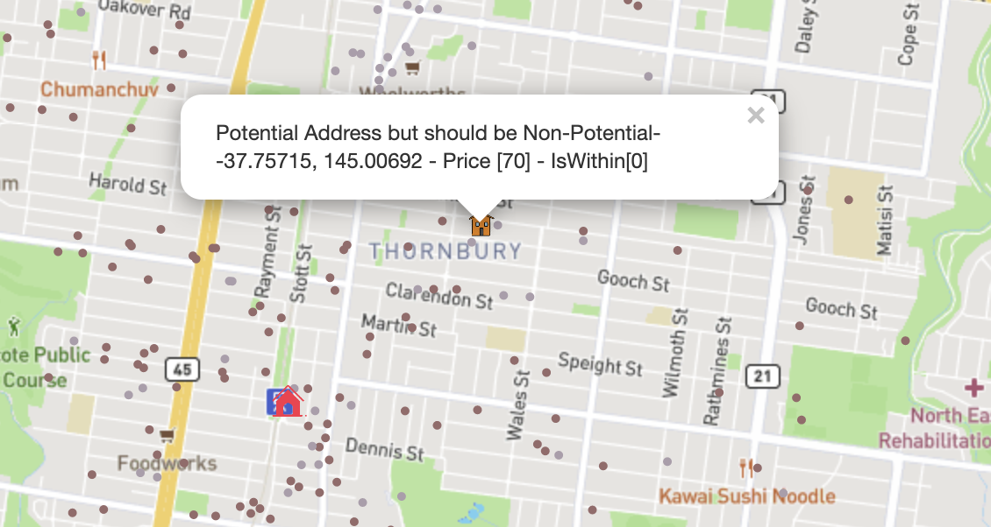
USE case -3(C)
False Positive Acquisitions Visualized
Potential House address predicted, but should be Non-Potential (False Positive)

Slide 11
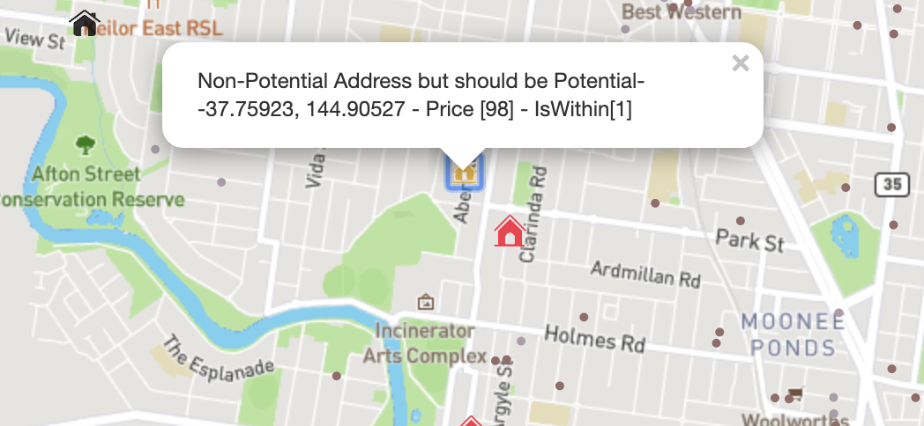
USE case -3(D)
False Negative Predictions Visualized
Non-Potential House address predicted, but should be Potential (False Negative)

Slide 12
Methodology
Ingest Data from Two sources – Popular Places, Airbnb Listings and store in memory
Tweak results of Airbnb Listing via internal algorithm
Expose results through REST API (Akka HTTP)
Introduce Logistic Regression
Implement Kafka Streaming
Implement Akka Actor Model to send data from the results of the model to the backend service
Implement UI and Introduce Leaflet for MAP-like interface

Slide 13
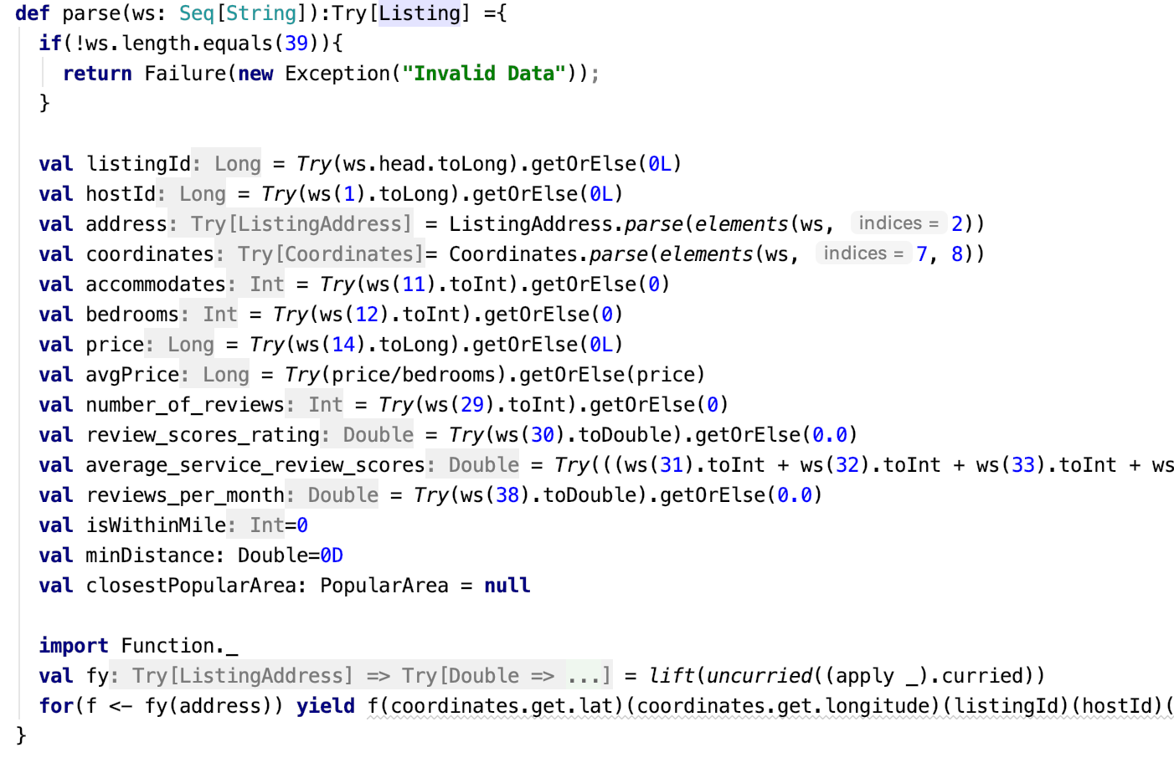
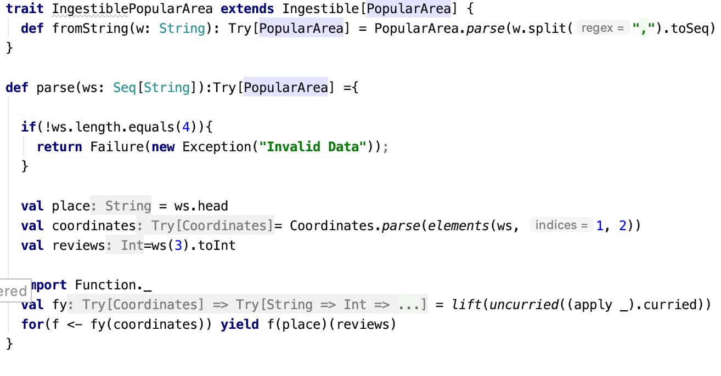
Methodology - 1
Ingest Data from Two sources – Popular Places, Airbnb Listings and store in memory
Listing
PopularArea

Slide 14
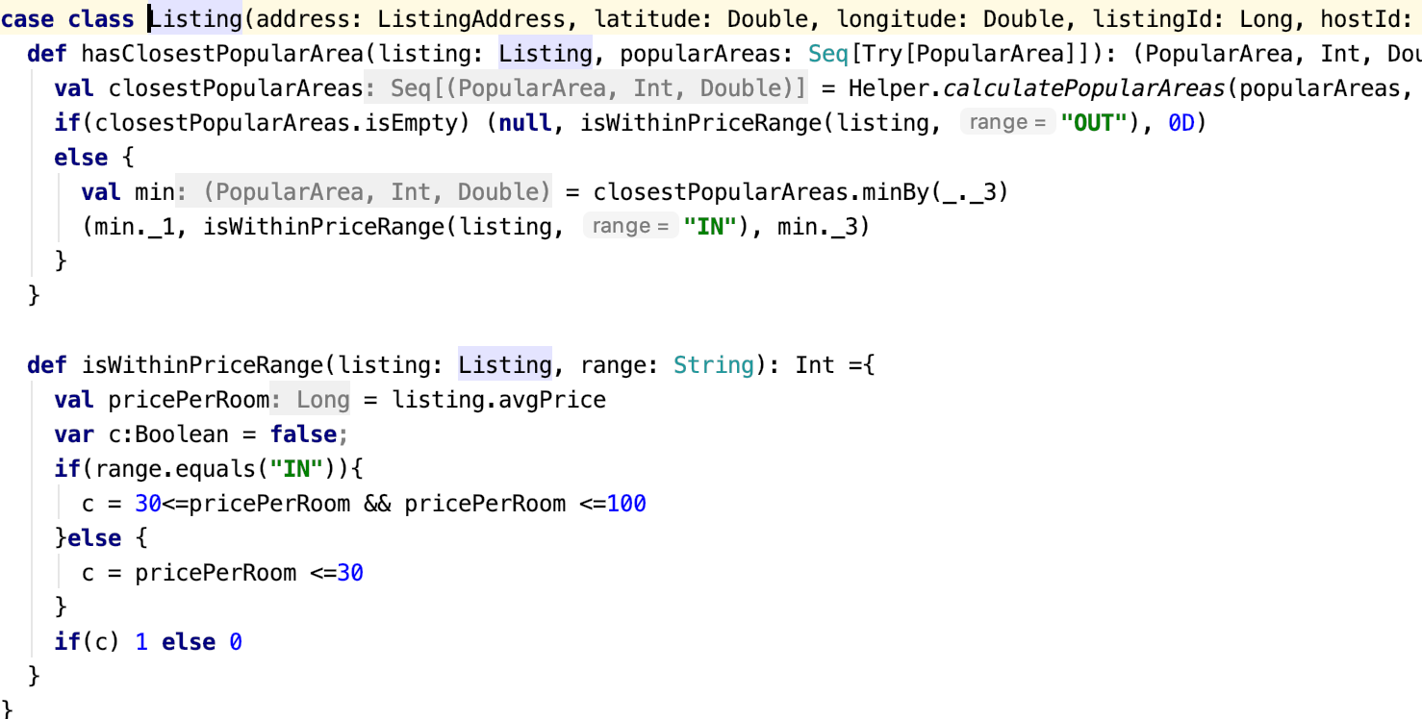
Methodology - 2
Tweak results of Airbnb Listing via internal algorithm
Listing
PopularArea

Slide 15
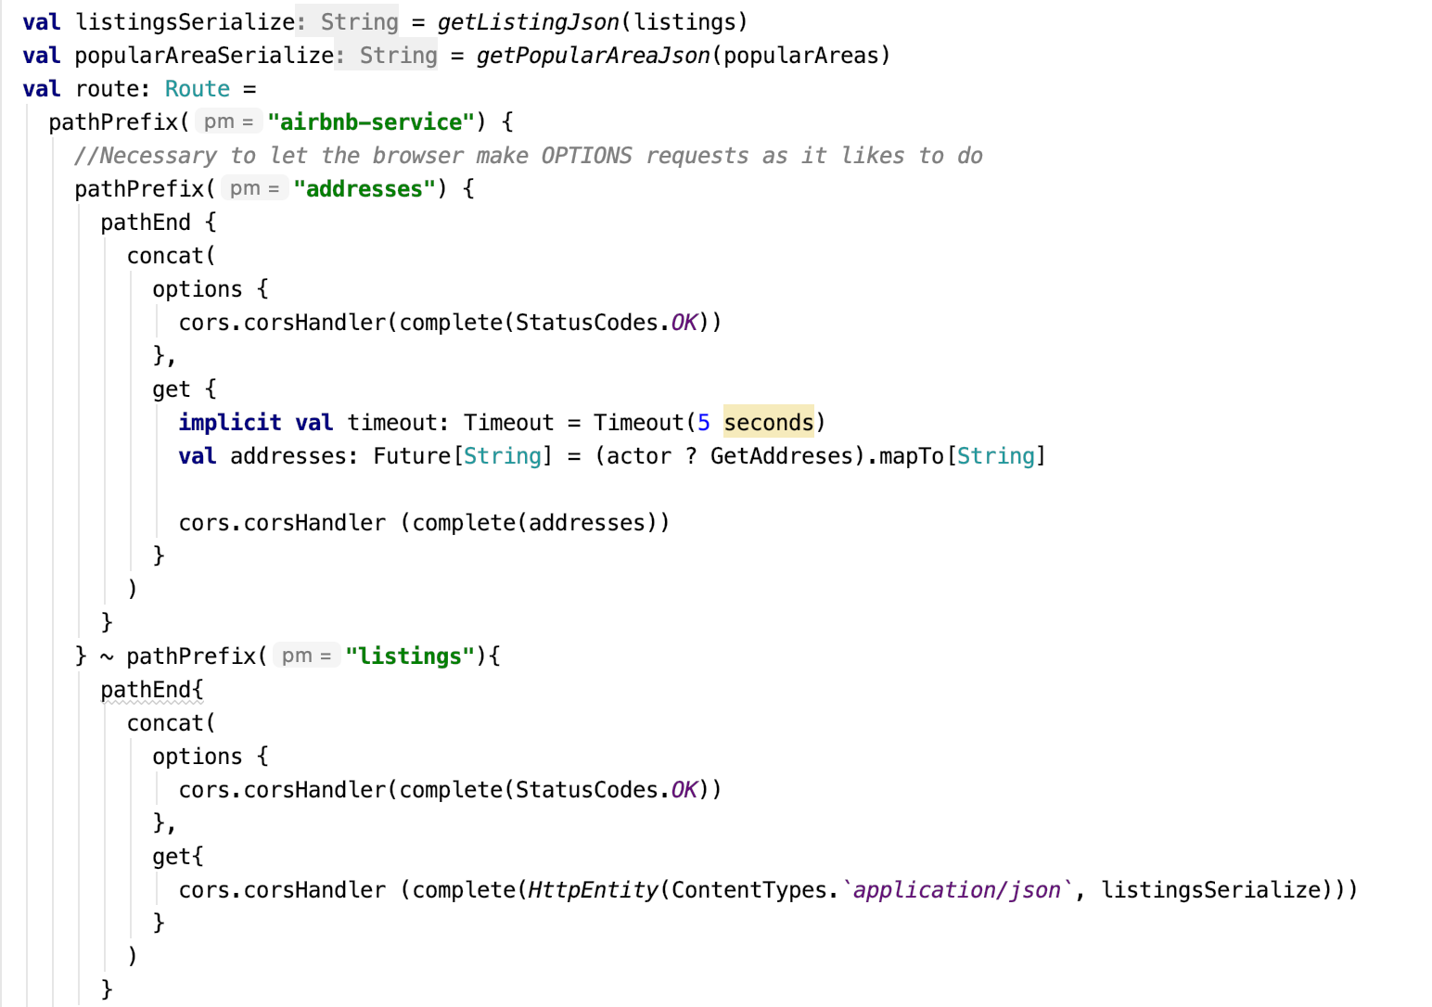
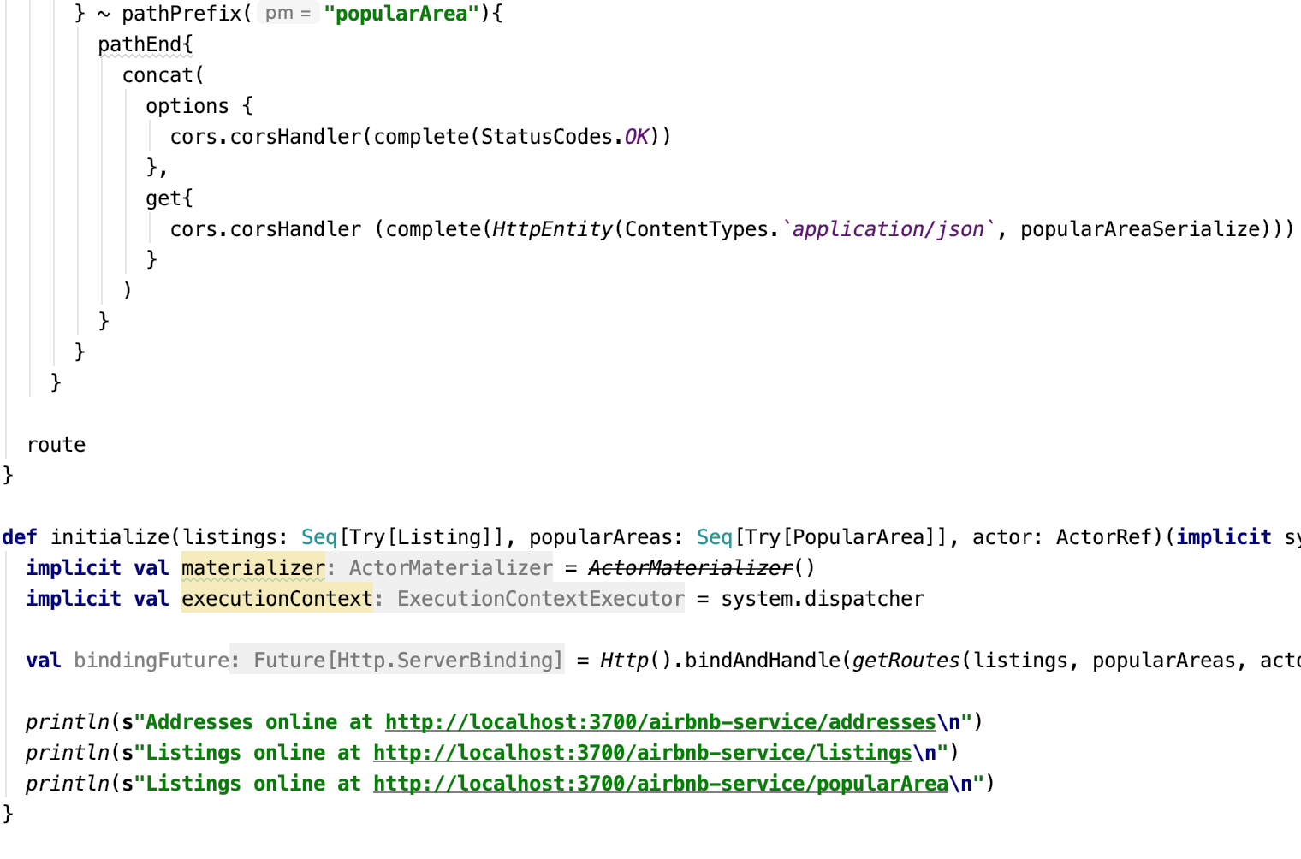
Methodology - 3
Expose results through REST API (Akka HTTP)

Slide 16
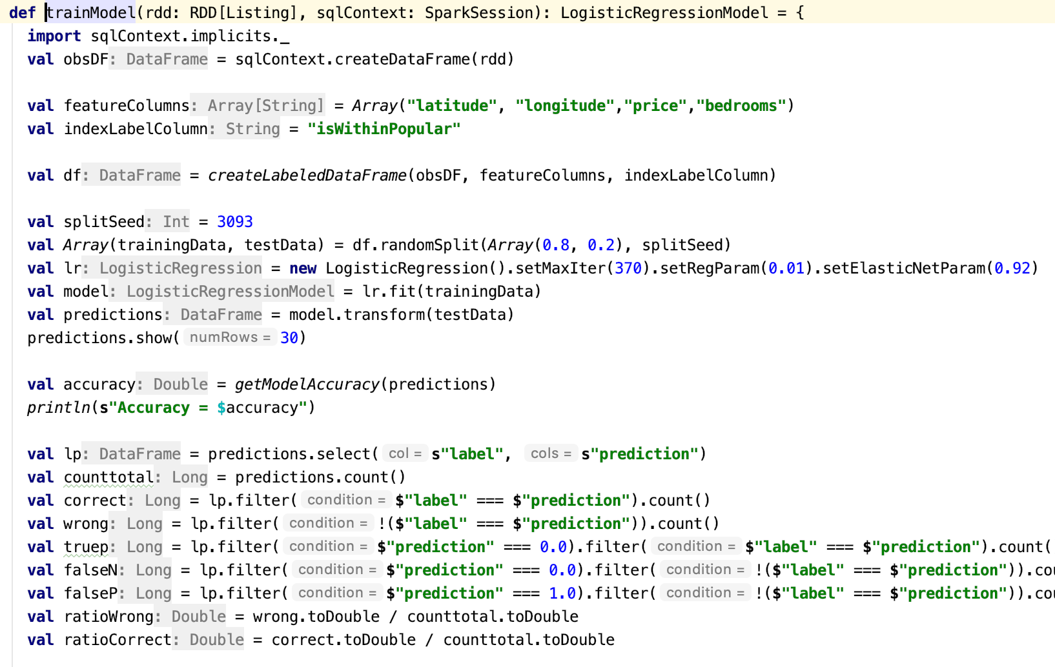
Methodology - 4
Introduce Logistic Regression

Slide 17
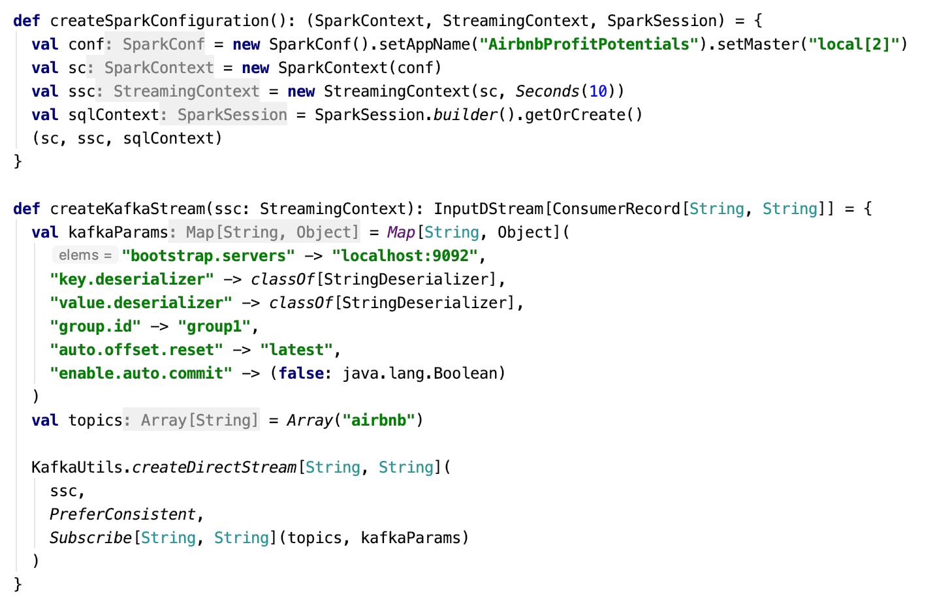
Methodology - 5
Implement Kafka Streaming

Slide 18
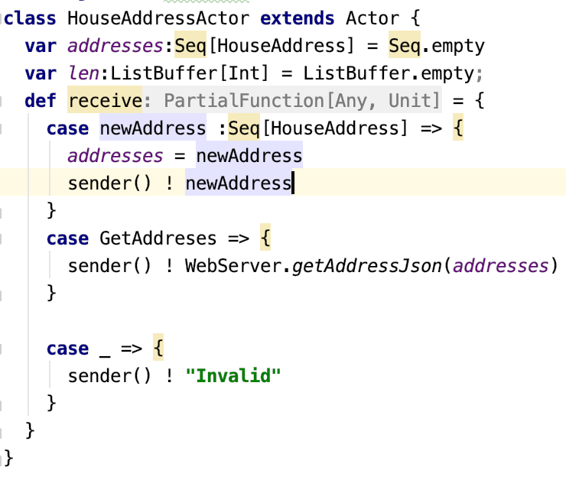
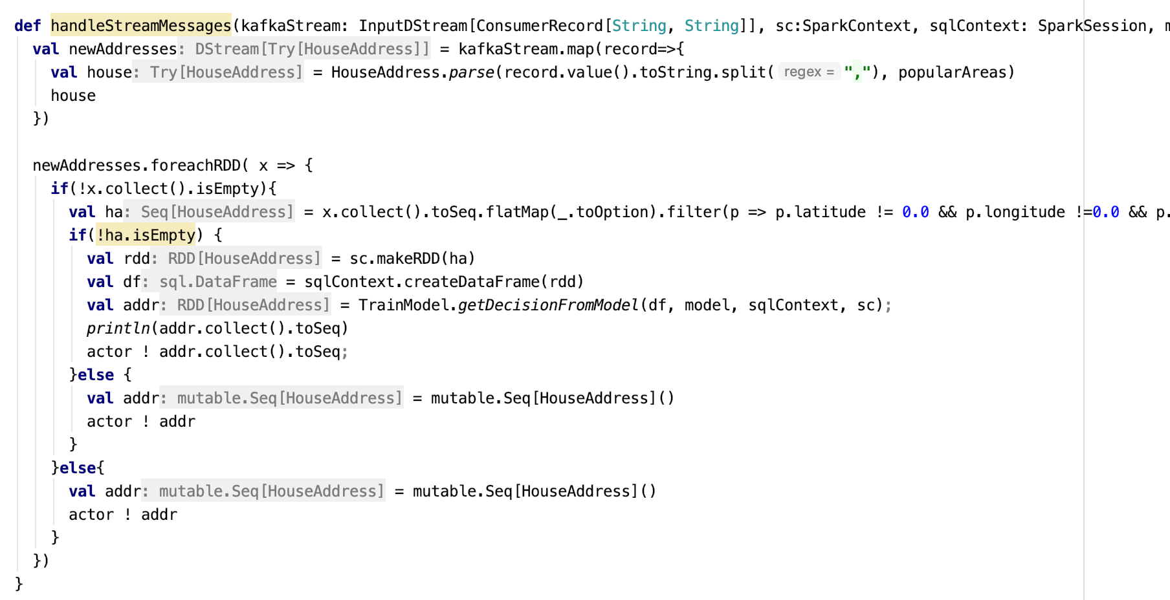
Methodology - 6
Implement Akka Actor Model to send data from the results of the model to the backend service

Slide 19
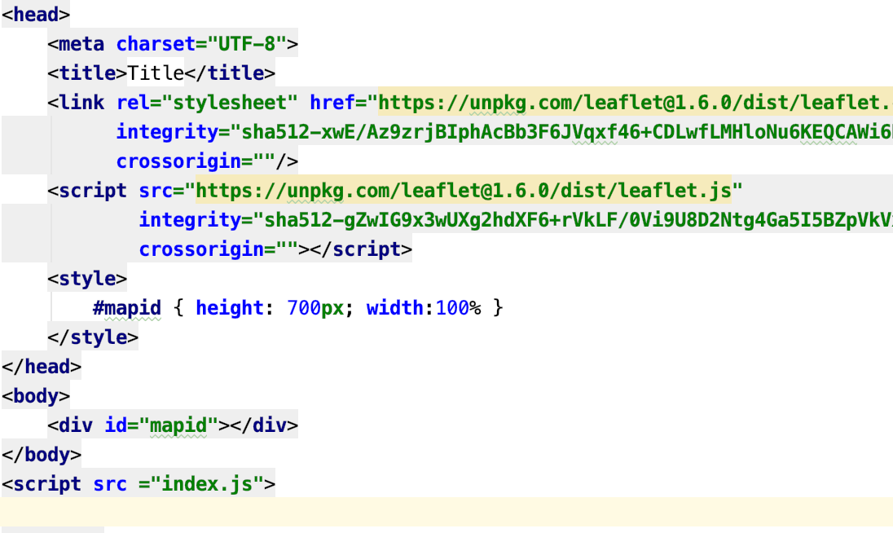
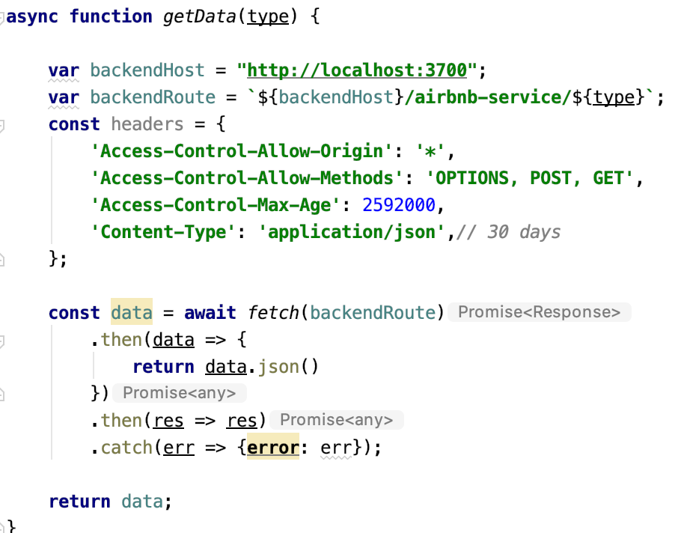
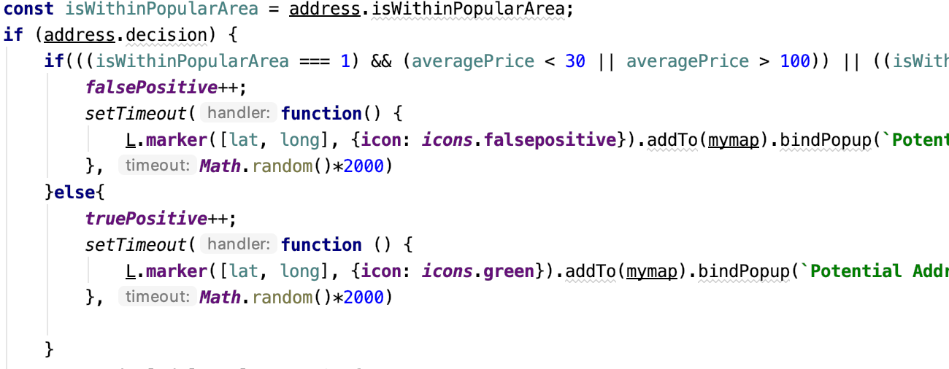
Methodology - 7
Implement UI and Introduce Leaflet for MAP-like interface

Slide 20
Data sources
Melbourne Airbnb Listing Data – 16K+ Rows
Popular Visited Places in Melbourne – 30 Rows
House addresses – 35K+ Rows

Slide 21
Milestones/sprints
4 sprints of 1 week each
1st sprint - Filtering data – 16th Mar – 22nd Mar
2nd sprint - Actual backend logic – 23rd Mar- 29th Mar
3rd sprint - Building pipelines – 30th Mar – 5th Apr
4th sprint – Visualization – 6th Apr – 12th Apr

Slide 22
Code in scala
Ingestion of data
Data processing
Akka model
Spark MlLib
Kafka Streaming
Algorithm to target potential properties
Backend Service Akka-HTTP
Unit+Integration Tests
Code repo on Github: https://github.com/rajatjaswal/csye7200-airbnb

Slide 23
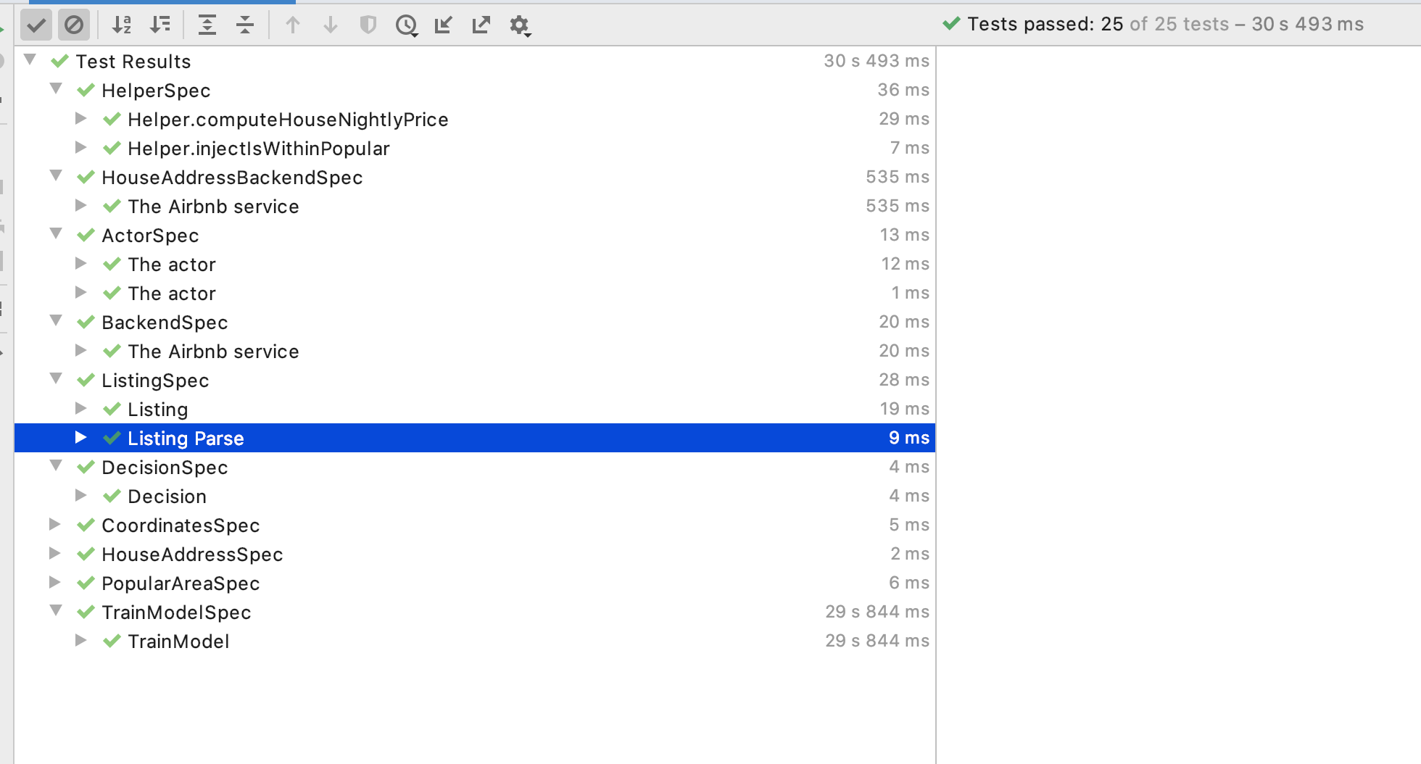
TESTS

Slide 24
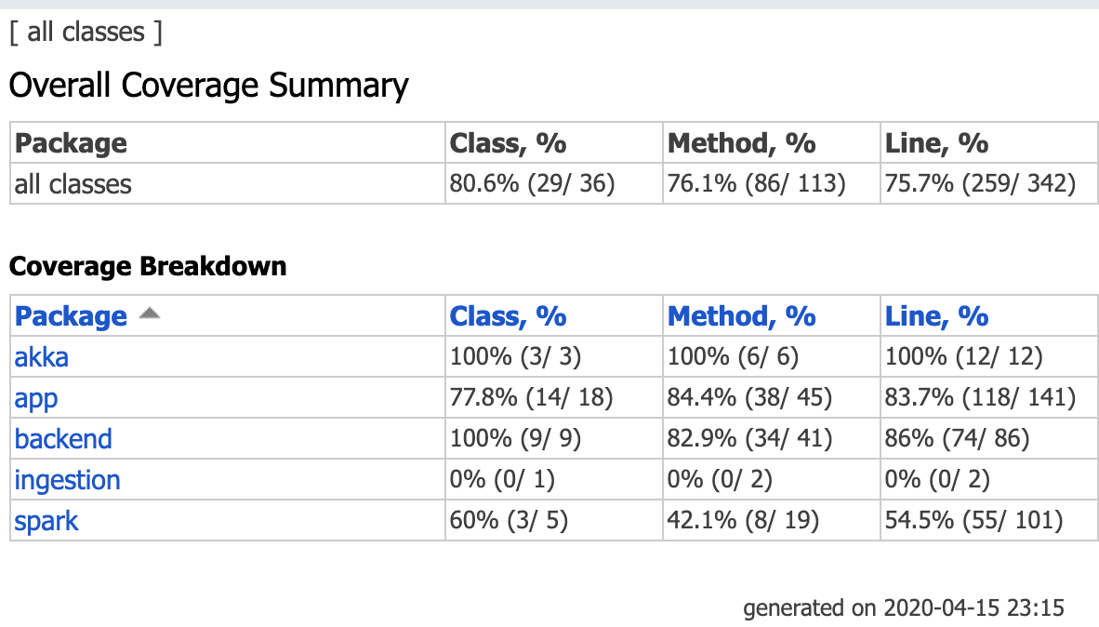
TESTS - Continued

Slide 25
Acceptance criteria
User queries for a city should not take more than 5 seconds to process and not more than 15 seconds overall to display visualizations
Error rate for suggestions should be less than 2% for reliable system

Slide 26
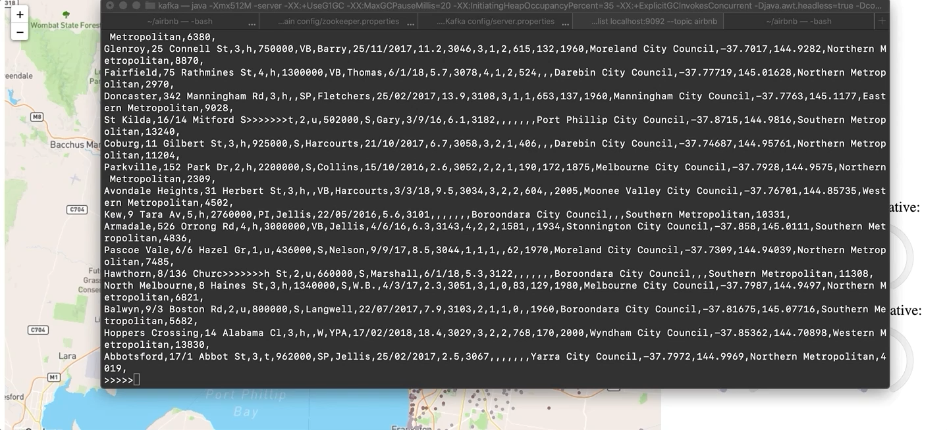
Demonstration

Slide 27
THANKYOU

